Slide 1





MEDICARE
Team Members: Guide:
YADAV ANAND RAMSINGH (ET23MTCA070)
MISHRA AKRUTI CHANDRASHEKHAR(ET23MTCA030)
JAIN APURVA (ET23MTCA020)
PATEL SAKSHI (ET23MTCA)
Adarsh Patel Sir
Disclaimer: The content is curated for educational purposes only.

Slide 2
OUTLINE
Abstract
Problem Statement
Aims, Objective & Proposed System/Solution
System Design/Architecture
System Development Approach (Technology Used)
Algorithm & Deployment
Conclusion
Future Scope
References
Video of the Project
Notes:
These are the list of chapters that we are going to cover in these foundation codes. Those are chapter one what are AI and ML? chapter 2 applied Python programming in AI, and chapter 3 is exploratory data analysis for ML.

Slide 3

Abstract
Our Medicare application aims to develop a comprehensive web application for booking doctor appointments and purchasing medications online.
Utilizing the MERN stack (MongoDB, Express.js, React, Node.js), this application simplifies the process of accessing healthcare services and purchasing medication, ensuring convenience and efficiency for users.

Slide 4

Problem Statement
Accessing healthcare services can often be cumbersome, with long wait times for appointments and difficulties in procuring medications.
This project aims to solve these issues by providing a seamless platform for booking doctor appointments and purchasing medications online

Slide 5

Aim and Objective
To develop a user-friendly platform for healthcare services
Simplify the process of booking doctor appointments.
Provide an easy way to purchase medications online.

Slide 6

Proposed Solution
Users can register with email/password or log in using existing credentials.
Users can view available time slots of healthcare providers.
An integrated web application using the MERN stack, offering features like user authentication, appointment scheduling, and online pharmacy services.

Slide 7
System Architecture
The system consists of a frontend developed with React for a dynamic user interface, a backend powered by Node.js and Express.js for handling business logic, and MongoDB for data storage."

Slide 8

System Deployment Approach
MongoDB: NoSQL database for storing user information, appointments, and medication details.
Express.js: Backend framework for building RESTful APIs.
React: Frontend library for building user interfaces.
Node.js: Runtime environment for executing JavaScript on the server side.

Slide 9

Algorithm & Deployment
User Authentication: Secure login system using JWT.
Appointment Scheduling: Conflict-free appointment booking system.
The application is deployed on Heroku with continuous integration and deployment setup.

Slide 10
Conclusion
Medicare Application successfully provides a streamlined platform for booking doctor appointments and purchasing medications online.
By leveraging the MERN stack, we ensure a robust, scalable, and user-friendly application.

Slide 11
Future Scope
Integration with telemedicine services for virtual consultations.
Advanced analytics for predicting healthcare trends and demands.
Mobile application development for greater accessibility.

Slide 12
Reference
https://netninja.dev/courses/category/node-js
https://www.youtube.com/@codewithantonio
https://academy.postman.com/
https://reactrouter.com/en/main
https://stackoverflow.com/
https://www.youtube.com/user/TechGuyWeb
https://www.udemy.com/
Notes:
Reference
These are the references for this session.
12

Slide 13
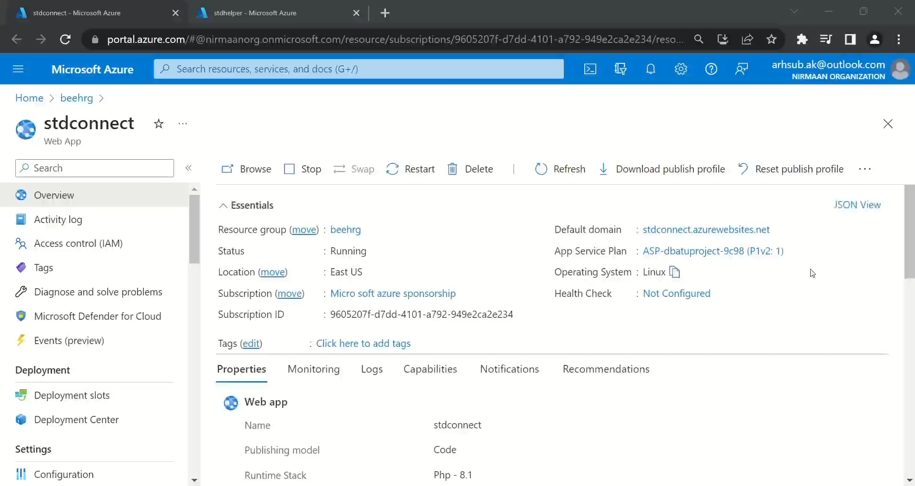

Slide 14
Thank you!
Notes:
thank you very much for joining this PPT, keep learning.
14

